Slide 1
Problem Statement:
Designing a billing system for malls to reduce cumbersome task .
Problem
It is generally seen in malls that due to large queue for the billing, people are required to wait for a longer time which results in a wastage of time and becomes cumbersome for the customer executive to perform billing. to avoid such problems we are developing a software which could save the time and forward us towards the digital world while advancing in the technology.
Problem Number: STH-24
Team Name: Code Warrior’s
Team Leader Name: Shruti Choudhary
College Name :Poornima Institute of Engineering & Technology

Slide 2






Solutions:
.
Technology Stack
. To reduce the time and troublesome work of malls .
This will help us to reduce the waiting queue.
At the end, customer can easily calculate the total amount.
To reduce the manual work.

Slide 3
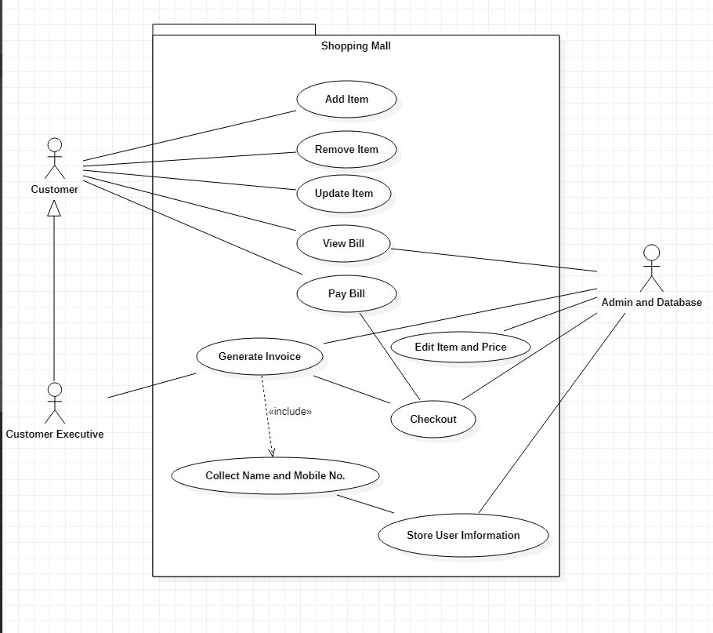
Use Case Diagram
Dependencies:
User should have the knowledge of using the Application
Database should be updated regularly

